Slide 1
PILOT STUDENTS – Oct/Nov 2015 (this applies to you)
(1) When you see an instruction to upload something, upload it to your desktop. If faculty needs it, they will ask for it.
(2) Contact info is in the FAQ for any issues.
NoSQL Databases
Module 1
Essentials
Notes:
Note to Narrator: Do NOT narrate any words, acronyms, or anything enclosed in ( ) that’s in the narrative script.

Slide 2

What This Course is About
Based on a theoretic foundation, we will tackle data stores from multiple angles.
Here are some points that this course will cover:
An introduction to data, comparing Structured vs Unstructured Data
A tour through common databases in the noSQL space and their characteristics
What is NoSQL and how is it different from RDBMS
Advantages and challenges of using NoSQL
Basic understanding of data distribution principles
A sound theoretic founding for distributed computing, helping you to get through the fog of marketing (CAP)
Setting up for a lab on virtual machines and running NoSQL
Notes:
Narration
The aim of this course is to help you make smart decisions about your data store. We introduce key terms, provide a short history and help you understand the theory of distributed computing.
In addition, you will be introduced to a clean model for distributed data and classifications of data stores.
This section will help you decide which data stores or combination of data stores are needed for your project. Finally, we will tour common databases in noSQL and evaluate tradeoffs based on your business needs.
Let us get started.

Slide 3

Key Terminology
Below are the key terms that are used throughout the course.
Sharding/Distribution: Refers to cutting and distributing of data when it is too big for one machine to store
Active/Passive: Refers to a popular method to achieve high(er) availability; adds a machine that is always in hot standby (passive) in case the active one crashes
Master/Slave: Refers to a typical method of scaling when the read/write ratio is high; all writes, for example per shard, are synchronized via the master and slaves handle only the reads
RDBMS: Relational database management system
Notes:
Narration
These are the key terms used throughout this course. Let us review each key term.
Whenever data is too big for one machine to store or query, which is even more complex, you need to somehow cut it into pieces and distribute the data across multiple machines. This process is referred to as sharding. For everyone who knows Oracle databases, the foundation there is partitioning, so you split it up in some way.
Active/Passive is a popular method to achieve higher availability. There is an active machine dealing with all the data on an active database server. There is another, the passive machine, standing by to take over all the work should the active machine crash.
In a master/slave operation, you have both machines active because having one machine just sitting idle does not really add any value. This is a typical way to scale if the read/write ratio is high. For example, if all writes go to the master, the slave can be used for reads. With that, you can scale in the reads and still get a higher availability. This is a very typical approach employed by relational databases such as Oracle, mySQL or MSSQL [Narrator: say the letters] and so forth. They all support this model at the very core.
Finally, there is locks and versioning. Whenever concurrent access happens and the database wants to guarantee some kind of consistency, either the database has to block concurrent accesses to make sure that one wins or you have to use a versioning scheme that can give you consistency if you say, the last one wins or the first one wins. In very extreme cases, where it is no longer so consistent, you can even have multiple versions. There are enough noSQL data stores that allow you to have multiple versions. A relational database has only one active version; hence, there will always be some kind of winner in a concurrency race.

Slide 4

Course Objectives
Here are some points that this course will cover:
An introduction to data, comparing Structured vs Unstructured Data
A tour through common databases in the noSQL space and their characteristics
What is NoSQL and how is it different from RDBMS
Advantages and challenges of using NoSQL
Basic understanding of data distribution principles
A sound theoretic founding for distributed computing, helping you to get through the fog of marketing (CAP)
Setting up for a lab on virtual machines and running NoSQL
Notes:
Narrative:

Slide 5
This Week’s Outline
Introduction
Overview of Data Essentials
SQL vs NoSQL
Data Architecture slide
Deeper dive into NoSQL Architecture
NoSQL as part of an enterprise architecture stack
Major players (brief)
Etc.
Notes:
Narrative:

Slide 6
Module 1: Introduction

Slide 7
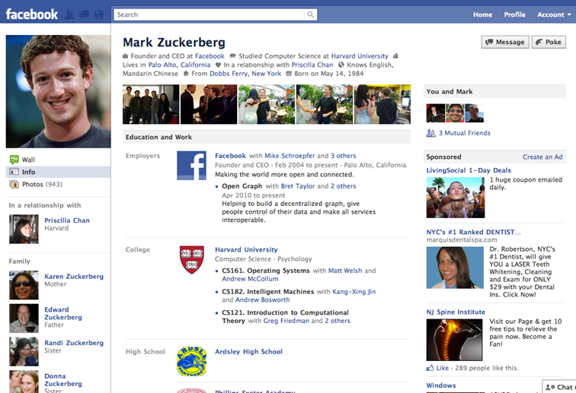
What is Data?
Data is all around us. But what exactly is it? Data is a value assigned to a thing.
Take the following Facebook profile for example, what are some of the data observations that we can make:
Name: Mark Zuckerberg
Age: 30
Occupation: Founder and CEO at Facebook
Languages spoken: English, Mandarin Chinese

Slide 8
Major Types of Data
There are two major categories of data:
Qualitative data is a categorical measurement describing the qualities of something that can be categorized. (E.g. color, experience level, gender)
Quantitative data is a numerical measurement and can be mathematically manipulated. (E.g. height, length, a score on a test)

Slide 9
Getting information from data
Data, when collected and structured suddenly becomes a lot more useful.
This is information. But it still is not knowledge. Knowledge is created when the information is learned, applied and understood.
Name | Age | Occupation | Languages Spoken
Mark Zuckerberg | 30 | Founder/CEO | English, Mandarin Chinese
Dustin Moskovitz | 30 | Software Engineer | English
Mike Schroepfer | 40 | CTO | English

Slide 10
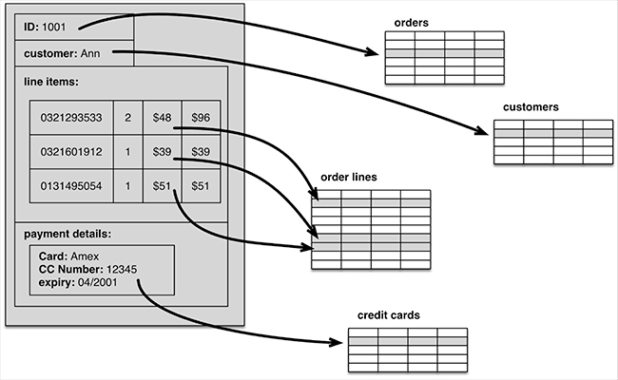
Structured Data
(Data for Computers)
Structured data are data that are organized in a format easily used by a database or other technology.
E.g. relational databases, spreadsheets, etc.
Structured data is organized in such a way that a computer can process and analyze it and thus is machine-readable
Notes:
Structured data first depends on creating a data model – a model of the types of business data that will be recorded and how they will be stored, processed and accessed. This includes defining what fields of data will be stored and how that data will be stored: data type (numeric, currency, alphabetic, name, date, address) and any restrictions on the data input (number of characters; restricted to certain terms such as Mr., Ms. or Dr.; M or F).
Structured data has the advantage of being easily entered, stored, queried and analyzed. At one time, because of the high cost and performance limitations of storage, memory and processing, relational databases and spreadsheets using structured data were the only way to effectively manage data. Anything that couldn't fit into a tightly organized structure would have to be stored on paper in a filing cabinet.

Slide 11

Unstructured Data
Unstructured data (Data for humans)
Unstructured data represents any data that does not have a recognizable structure. It is unorganized and raw and can be non-textual or textual.
e.g. tweets, images, mp3 files, emails, books, etc.
Unstructured data can be pleasing to the human eye, but are not machine readable
Notes:
A plain sentence – “we have 5 white used golf balls with a diameter of 43mm at 50 cents each” – might be easy to understand for a human, but for a computer this is hard to understand. The above sentence is what we call unstructured data. Unstructured has no fixed underlying structure – the sentence could easily be changed and it’s not clear which word refers to what exactly. Likewise, PDFs and scanned images may contain information which is pleasing to the human-eye as it is laid-out nicely, but they are not machine-readable.
Computers are inherently different from humans. It can be exceptionally hard to make computers extract information from certain sources. Some tasks that humans find easy are still difficult to automate with computers. For example, interpreting text that is presented as an image is still a challenge for a computer. If you want your computer to process and analyse your data, it has to be able to read and process the data. This means it needs to be structured and in a machine-readableform.
Unstructured data refers to data that follows a form that is less ordered than items like spreadsheet pages, database tables or other linear or ordered data sets. In fact, the term "data set" is helpful because it is associated with data that is in neat, accessible arrays, without any extra content, and that is linked or tagged in a specific structure. Other instances of unstructured textual data include Word documents, PowerPoint presentations, instant messages, collaboration software, documents, books, social media posts and medical records. Non-textual unstructured data is generally created in media, such as MP3 audio files, JPEG images and Flash video files, etc. Unstructured data usually does not include a predefined data model, and it may not match well with relational tables. Unstructured data is usually text heavy. However, it may include numbers and dates, as well as facts. This leads to ambiguities that are difficult to identify using conventional software programs

Slide 12
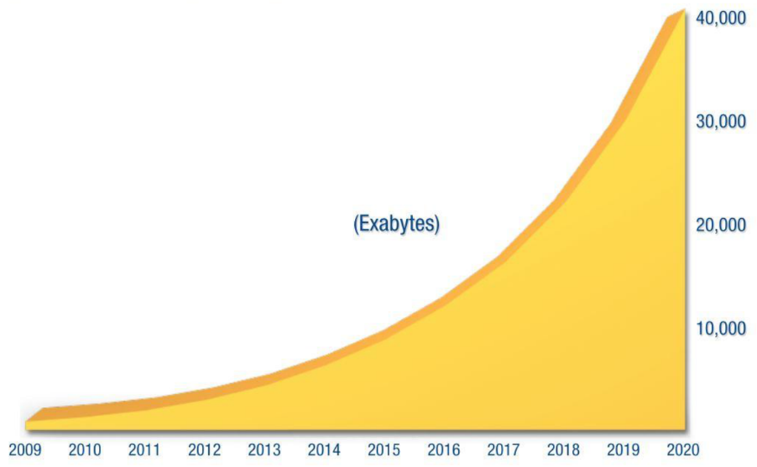
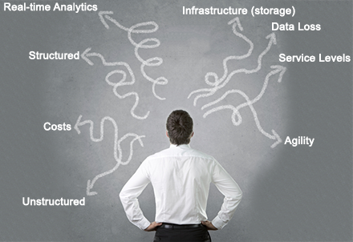
Data is Big and Complexity is Growing
Two ways that data is changing include:
Data is Big
Complexity is Growing
Source: IDC’s Digital Universe Study (sponsored by EMC) December 2012
Notes:
Narration
What is this noSQL Essentials course about and why are we dealing with these topics? There has been a shakeup of the storage market and there is one core cause: data is growing, and it is growing quickly and getting more complex. It is almost impossible to structure it.
On the left side of your screen, we see the latest IDC study showing that data is growing in exabytes. IDC has revised their study upward every year since 2007, and data grows faster and faster each year.
In addition to growing, data is becoming different. It is unstructured and we demand more of it. We want to store it at lower costs. We want to have a certain agility and deal with data loss. You will hear many fancy buzzwords such as real-time, analytics and predictive analytics. All these desires apply new requirements on the data.

Slide 13
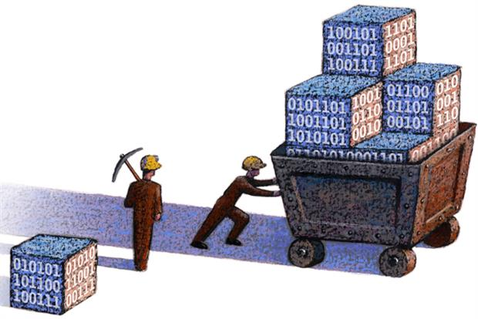
Processing Data
Previously, schemas had to be created by hand to organize data. In order to do this, the structure had to be known beforehand
This data could then be queried using SQL. Structured data is often managed using Structured Query Language (SQL) – a programming language created for managing and querying data in relational database management systems. (RDBMS)
Notes:
In the past, structured data was the norm, and much of structuring data was done by human hands. (e.g. humans mined documents for fixed-length information that could be built into database tables).
This is leading to a major change in how companies collect, store and use data, with high-powered analytics systems and other resources. In turn, this has a major effect on business operations, for example customer relationships, supply chains, and internal efforts to grow or expand a business.

Slide 14

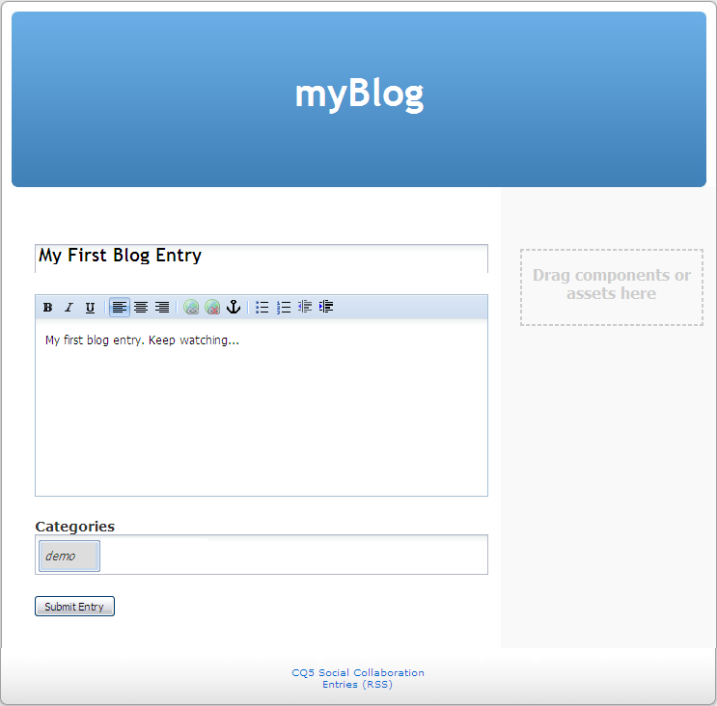
Databases Overview
A database is a collection of information that is organized so that it can easily be accessed, managed, and updated.
There are two main types of databases depending on whether the data is structured or unstructured:
Relational/Structured Database
Non-Relational/Unstructured Database
To understand the difference, let’s take a look at a simple app that we can use to create blog entries.
Notes:
A database is a collection of information organized to provide efficient retrieval. The collected information could be in any number of formats (electronic, printed, graphic, audio, statistical, combinations). There are physical (paper/print) and electronic databases.
For example, consider a simple application that allows users to create blog entries. In this application, blog entries are categorized by subject area (sports, fashion, and so on.). Users can also choose to subscribe to the blogs of other users. In this example, the user id is the primary key in the users table and the foreign key in the blog and subscriber tables. Likewise, the categoryid is the primary key of the category table and the foreign key in the blog_entry table.

Slide 15
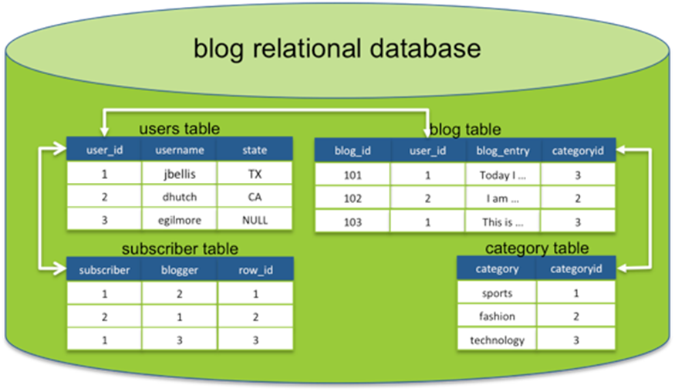
Relational Databases
Each table is known as a relation
Notes:
In a relational database, data is stored in tables and the tables comprising an application are typically related to each other.
DBs organize data in different ways. Each table is known as a relation, which contains one or more data category columns. Each table record (or row) contains a unique data instance defined for a corresponding column category. One or more data or record characteristics relate to one or many records to form functional dependencies. These are classified as follows:
One to One: One table record relates to another record in another table.
One to Many: One table record relates to many records in another table.
Many to One: More than one table record relates to another table record.
Many to Many: More than one table record relates to more than one record in another table.
RDB performs "select", "project" and "join" database operations, where select is used for data retrieval, project identifies data attributes, and join combines relations.
Using this relational model, SQL queries can perform joins on the various tables to answer questions such as "what users subscribe to my blog" or "show me all of the blog entries about fashion" or "show me the most recent entries for the blogs I subscribe to".

Slide 16
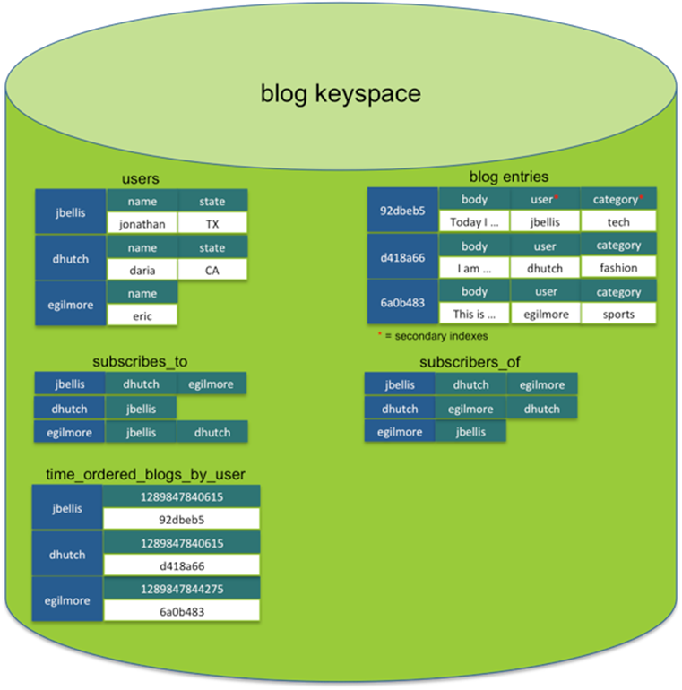
Unstructured Database
Notes:
A non-relational database is a database that does not incorporate the table/key model that relational database management systems (RDBMS) promote. These kinds of databases require data manipulation techniques and processes designed to provide solutions to big data problems that big companies face. The most popular emerging non-relational database is called NoSQL (Not Only SQL).
Unstructured databases do not have forced relationships between column families the way that relational databases do between tables.
Each column family has a self-contained set of columns that are intended to be accessed together to satisfy specific queries from your application.
Most non-relational databases are incorporated into websites such as Google,Yahoo!, Amazon and Facebook. These websites introduce a slew of new applications every single day with millions and millions of users, so they would not be able to handle large traffic spikes with existing RDBMS solutions. Since RDBMS cannot handle the problem, they’ve switched to a new kind of DBMS that is capable of handling Web scale data in a non-relational way. An interesting aspect of a non-relational database such as NoSQL is scalability. NoSQL uses the BASE system (basically available, soft-state, eventually consistent). Non-relational databases forgo the table form of rows and columns relational databases use in favor of specialized frameworks to store data, which can be accessed by special query APIs. Persistence is an important element in these databases. To enable fast throughput of vast amounts of data the best option for performance is "in memory," rather than reading and writing from disks.
For example, using the blog application example, you might have a column family for user data and blog entries similar to the relational model. Other column families (or secondary indexes) could then be added to support the queries your application needs to perform. For example, to answer the queries:
What users subscribe to my blog?
Show me all of the blog entries about fashion.
Show me the most recent entries for the blogs I subscribe to.

Slide 17
Introduction to NoSQL

Slide 18
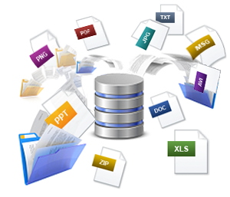
How Can We Process Unstructured Data?
As of recently, different types of NoSQL technologies and other advances have led to the collection and use of unstructured data, where computer systems can analyze unstructured data in more precise ways.

Slide 19
Background of NoSQL
Relational databases have controlled the software industry for the past decades providing mechanisms to store data and generate reports.
The dominance of relational databases is slowly peaking downwards
In recent years, NoSQL databases have become more relevant and are challenging the existing relational database systems.

Slide 20

The New Buzzword Everyone Tries to Claim: noSQL
Many people think that noSQL stands for “no SQL”, while it actually means “not only SQL”.
What do you call an expert who does not know SQL?
A noSQL expert!
Notes:
Narration
As usual, the solution is a new buzzword, and everyone tries to claim they know something about it on their resumes.
Just like the illustration hints, if you have no experience whatsoever, you can just write noSQL expert in your resume and you are essentially a professional.
In this course, we will see that there is much more to being an expert in noSQL.

Slide 21
What is No SQL
NoSQL means Not Only SQL, implying that when designing a software solution or product, there are more than one storage mechanism that could be used based on the needs.
NoSQL does not have a prescriptive definition but we can make a set of common observations, such as:
Not using the relational model
Running well on clusters
Mostly open-source
Built for the 21st century web estates
Schema-less

Slide 22
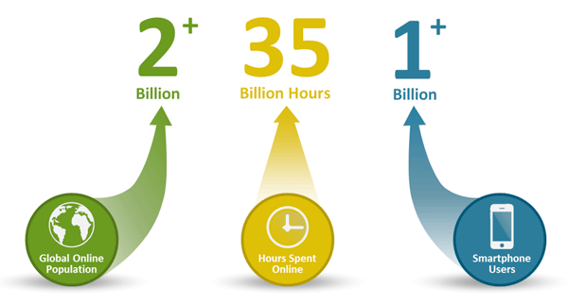
Why NoSQL
To improve programmer productivity by using a database that better matches an application's needs.
To improve data access performance via some combination of handling larger data volumes, reducing latency, and improving throughput.
Notes:
Application developers have been frustrated with the impedance mismatch between the relational data structures and the in-memory data structures of the application. Using NoSQL databases allows developers to develop without having to convert in-memory structures to relational structures.
Global Internet usage is growing rapidly, as is the amount of time each user spends online daily. With the proliferation of smart phones, people use their apps even more frequently. Increasing use of online apps means a rapidly growing number of database operations and the need for a much easier way to scale the database to meet these demands.
The first reason to use NoSQL is because you have big data projects to tackle. A big data project is normally typified by: 1. Data velocity – lots of data coming in very quickly, possibly from different locations 2. Data variety – storage of data that is structured, semi-structured, and unstructured 3. Data volume – data that involves many terabytes or petabytes in size 4. Data complexity – data that is stored and managed in different locales, data centers, or cloud geo-zones
NoSQL databases are also simple and inexpensive compared with their relational counterparts. The simplicity contributes to fast development and fast performance at scale. Many (though not all) NoSQL databases are open source, so you can get started with free community software and add commercial support and helpful commercial add-on modules as your deployment grows. Given that the biggest dissatisfaction with existing databases comes from licensing costs and terms, free and open will look appealing to many IT teams, especially those bootstrapping a pilot project.

Slide 23

Case Study: Netflix
Goal: As Netflix’s user base and data was rising after streaming services were introduces, a solution was needed to build fast, fault tolerant systems at Internet scale.
Challenges:
Affordable capacity to store and process vast amounts of data
Single point of failure SQL Database
Achieving business agility for international expansion
Results (after implementing noSQL)
New system delivers a throughput of more than 10 million transactions per second
Effortless creation/management of new data clusters across various regions
Capture of every detail of customer viewing and log data
Notes:
Let’s take a look at an example of how NoSQL can be useful. Netflix is the world’s leading Internet television network with more than 48 million streaming members in more than 40 countries. Early on, Netflix was managed on a single Oracle SQL database. As Netflix's "watch now" streaming service has grown, the company has had to rethink its data and storage strategies to cope with ballooning workloads managed in the cloud. Today, the company is nearly complete in its migration from Oracle SQL database to the NoSQL database Cassandra, improving availability and essentially eliminating downtime incurred by database schema changes.
Netflix launched its streaming service in 2007, using the Oracle database as the back end. "We had a single data center, which meant we had a single point of failure," explains Adrian Cockcroft, cloud architect at Netflix. "We were approaching limits on trafﬁc and capacity. Now that people can watch Netflix streaming programming from their phones, from Wii devices, Roku boxes, and many others, the demand for availability increases all the time. We have more customers every quarter, more customers are using streaming, and they're using streaming at a greater rate."
Challenges:
Affordable capacity to store and process immense amounts of data (more than 2.1 billion reads and 4.3 billion writes per day)
Single point of failure with Oracle’s legacy regional architecture using Oracle SQL database
Achieving business agility for international expansion
In 2010, Netflix began moving its data to Amazon Web Services. The next step was to replace its Oracle database with Apache Cassandra, an open source NoSQL database known for its scalability and enterprise-grade reliability. "For us, the problem with a central SQL database was that everything was in one place in which is only convenient until it fails," Cockcroft explains. "And because these databases are expensive, you tend to put everything in there. Then everything fails at once.“Another problem was that schema changes required system downtime. "Every two weeks, we'd have at least 10 minutes of downtime to put in the new schema," he explains. "The limitations of a SQL database impacted our availability and scalability."
Netflix learned that traditional relational database technologies were not built to accommodate large volumes of data, neither from a cost-effective perspective nor regarding the needs for continuous availability and flexibility. The Netflix team performed an extensive evaluation of their database options and chose Cassandra. Besides affordable scalability, Cassandra’s schemaless architecture ensures no single point of failure and eliminates any downtime incurred by schema changes. The entire migration of more than 80 clusters and 2500+ nodes was completed with only two engineers.
Results (after implementing noSQL)
New system delivers a throughput of more than 10 million transactions per second
Effortless creation/management of new data clusters across various regions
Capture of every detail of customer viewing and log data

Slide 24
Advantages

Slide 25


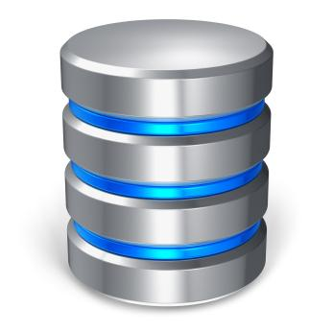
Limitations of RDBMS
RDBMS cannot meet the scales of big data
With RDBMS, the structure has to be known beforehand. As we can often see in areas like social media, the data used has no specific structure boundary.
Once the limits of the relational database has been reached, there isn’t any way to increase capacity
Moreover, if this database fails, the whole system has failed
Notes:
RDBMS operates with a relational model defined by schema, where each table is a strictly defined collection of rows and columns and a relationship can then be established between each row in one table and a row in another table.
The problem with the traditional RDBMS is that it is not a real time system. It is poll based. This means a query is constructed, submitted and the results are returned to the application. This itself may happen very quickly, maybe only a few ms to execute and receive a resultset. However the problem is of course, the data is only “valid” for the exact moment when the query was executed. From that moment onwards the data becomes stale and numerous changes could be happening on the data within the RDBMS while the extracted resultset is processed.
Relational databases power many different types of business applications, including customer relationship management systems and billing programs. These databases offer powerful information management tools to business leaders, but the technology behind a relational database also imposes limitations. These drawbacks become apparent not only within the database itself, but also in the mechanisms by which business applications access the data.
Data Complexity
Data in an RDBMS resides in multiple tables, which are linked to each other through shared key values. An RDBMS does not force database designers to impose a coherent table structure; inexperienced programmers may design systems that create unnecessary complexity or limit the future development of the database through poorly chosen data types. The flexibility of an RDBMS presents a double-edged sword. Experienced designers work magic, but inexperienced designers wreak havoc on a company's data.
Broken Keys and Records
Relational databases require shared keys to link information spread across several tables. For example, a customer table may include client demographics, with a unique index number identifying the record within the table. A sales table may identify the customer only by that index number. If the data types linking the keys are different, the database cannot link the records without additional rework by the report developer. Likewise, if a table lacks a unique key, the database may return inaccurate results. If the application accessing a database isn't coded to lock records during an edit, users could inadvertently corrupt data, leading to broken records.
Developer Expertise
As the complexity of a relational database increases, the skill set required by the RDBMS administrator, various users and report developers also increases. A mission-critical database may require expertise that exceeds the budget of a small business; furthermore, if the developers did not uniformly engage in best practice design, a subsequent developer may not understand hidden intricacies that could lead to broken queries or inaccurate reports. This risk increases if database and application development is performed by different people.
Hardware Performance
Complex queries require sophisticated processing power. Although most desktop computers can manage the databases of the size and complexity often encountered in a small business setting, a database with external data sources or very complex data structures may require more powerful servers to return results within an acceptable response time.

Slide 26
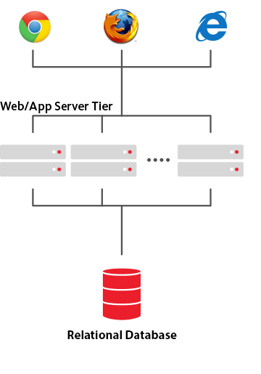
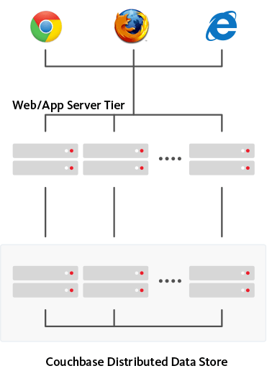
Scalability
With big data you want to be able to scale very rapidly and elastically, whenever and wherever you want.
Scaling Up with RDBMS: DB admins always relied on scaling up or buying bigger, expensive, multiple servers as database load increased.
Scaling Out with noSQL: DB admins can now simply add another server and distribute the load across multiple hosts. (We will learn more about this in the Data Distribution section)
Clustered Data Store
Notes:
NoSQL databases were developed from the ground up to be distributed, scale out databases that use a cluster of standard, physical or virtual servers to store data and support database operations.
To scale, additional servers are joined to the cluster, and the data and database operations are spread across the larger cluster. Since commodity servers are expected to fail from time-to-time, NoSQL databases are built to tolerate and recover from such failures, making them highly resilient.
NoSQL databases provide a much easier, linear approach to database scaling. If 10,000 new users start using your application, simply add another database server to your cluster. Add 10,000 more users and add another server.
There’s no need to modify the application as you scale since the application always sees a single (distributed) database.
At scale, a distributed scale out approach also usually ends up being less expensive than the scale up alternative. This is because large, complex, fault tolerant servers are expensive to design, build and support.
Licensing costs of commercial relational databases can also be prohibitive because they are priced with a single server in mind. NoSQL databases on the other hand are generally open source, priced to operate on a cluster of servers, and relatively inexpensive.

Slide 27
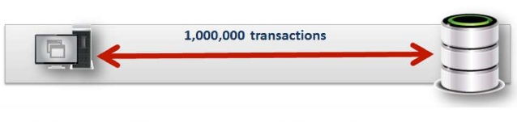
Capacity
RDBMS capacity has been growing to match the increase in volumes of data, but the limitations of data volumes that can be handled by a single RDBMS are intolerable for some enterprises. Hadoop, an enabler of certain types of NoSQL distributed databases, allow data to be spread across thousands of servers with little reduction in performance and it outstrips that which can be handled by the biggest RDBMS.

Slide 28
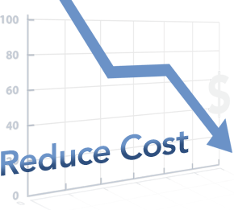
Costs
Server Costs: The cost to acquire another server is often cheaper than increasing than capacity of the current server
Maintenance: The cost to maintain each of the clusters is often less since they are smaller scale and there is no software that needs to be maintained on each cluster.
Notes:
Maintaining high-end RDBMS systems is expensive and can be only done with the assistance of expensive, highly trained DBAs. On the other hand, NoSQL databases require less management. Features like automatic repair, easier data distribution, and simpler data models make administration and tuning requirements lesser in NoSQL.
NoSQL databases typically use clusters of cheap commodity servers to manage the exploding data and transaction volumes, while RDBMS tends to rely on expensive proprietary servers and storage systems. So the storing and processing data cost per gigabyte in case of NoSQL can be many times lesser than the cost of RDBMS.
It frees the IT department from the headaches of provisioning hardware and systems software, setting up and configuring a distributed database cluster, and managing ongoing cluster operations. There are no hardware administration costs since there is no hardware to maintain. There are no NoSQL database administration costs such as patching the OS and managing the NoSQL cluster, since there is no software to maintain. You experience significant cost savings from both the elimination of hardware and software costs and from the elimination of manual database administration efforts. It handles all the complexities of scaling and partitions and re-partitions your data over more machine resources to meet your I/O performance requirements so you can focus on your application instead of worrying about infrastructure

Slide 29

Schema-less
Data can be inserted in a NoSQL database without first defining a rigid database schema.
Format or data model being inserted can be changed any time, providing flexibility.
Change management is a big headache in SQL. Here, even minor changes to the data model have to be carefully managed and may necessitate downtime or reduced service levels.
Notes:
RDBMS mandates that schema be defined before any data is added. It fits poorly with Agile Development methodologies where the schema often needs to change based on ever changing requirements.
If the data is huge, this process may involve significant (and frequent ofcourse due to agile development)downtime.
NoSQL databases are built to allow the insertion of data without a predefined schema. That makes it easy to make significant application changes in real-time, without worrying about service interruptions – which means development is faster, code integration is more reliable, and less database administrator time is needed.

Slide 30
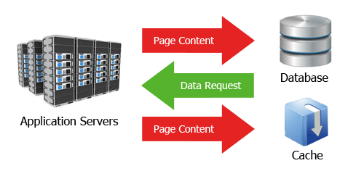
Caching
In order to increase data output and performance advance NoSQL techniques cache data in system memory. This is in contrast to SQL database where this has to be done using separate infrastructure.
Notes:
For SQL db systems, you need to use a third party system for caching. These systems may improve your read performance but make the system deployment a lot more complicated. Distributed caches can help if your application is read heavy but they wont help much if it is write heavy or a mix of reads and writes.
Many NoSQL database technologies have excellent integrated caching capabilities, keeping frequently-used data in system memory as much as possible and removing the need for a separate caching layer that must be maintained.

Slide 31
Challenges

Slide 32

Maturity
RDBMS has been around for a long time, thus there is a lot more expertise in this area. It will be the preferred choice for:
Stability
Abilities and Constraints already known
This is confusing!! I’ll stick with RDMBS
Notes:
RDBMS systems have been around for a long time. NoSQL advocates will argue that their advancing age is a sign of their obsolescence, but for most CIOs, the maturity of the RDBMS is reassuring. For the most part, RDBMS systems are stable and richly functional. In comparison, most NoSQL alternatives are in pre-production versions with many key features yet to be implemented.
Living on the technological leading edge is an exciting prospect for many developers, but enterprises should approach it with extreme caution.

Slide 33

Support
Support is widely available for RDBMS because it has been around for a long time
NoSQL systems are open source projects. Support not as widely available requiring you to find solutions on your own
Notes:
Enterprises want the reassurance that if a key system fails, they will be able to get timely and competent support. All RDBMS vendors go to great lengths to provide a high level of enterprise support.
In contrast, most NoSQL systems are open source projects, and although there are usually one or more firms offering support for each NoSQL database, these companies often are small start-ups without the global reach, support resources, or credibility of an Oracle, Microsoft, or IBM.

Slide 34

Analytics and business intelligence
Traditional SQL-centric BI tools are challenging if not impossible to use with data in NoSQL systems.
Even a simple query requires significant programming expertise, and commonly used BI tools do not provide connectivity to NoSQL.
NoSQL databases offer few facilities for ad-hoc query and analysis.
Notes:
NoSQL databases have evolved to meet the scaling demands of modern Web 2.0 applications. Consequently, most of their feature set is oriented toward the demands of these applications. However, data in an application has value to the business that goes beyond the insert-read-update-delete cycle of a typical Web application. Businesses mine information in corporate databases to improve their efficiency and competitiveness, and business intelligence (BI) is a key IT issue for all medium to large companies.
NoSQL databases offer few facilities for ad-hoc query and analysis. Even a simple query requires significant programming expertise, and commonly used BI tools do not provide connectivity to NoSQL.

Slide 35

Administration and Expertise
NoSQL today requires a lot of skill to install and a lot of effort to maintain.
Every NoSQL developer is in a learning mode and will continue to be in that mode until the noSQL is more widely accepted.
It is much easier to find experienced RDBMS developers for your business needs
RDBMS
NoSQL
Notes:
The design goals for NoSQL may be to provide a zero-admin solution, but the current reality falls well short of that goal. NoSQL today requires a lot of skill to install and a lot of effort to maintain.
There are literally millions of developers throughout the world, and in every business segment, who are familiar with RDBMS concepts and programming. In contrast, almost every NoSQL developer is in a learning mode. This situation will address naturally over time, but for now, it's far easier to find experienced RDBMS programmers or administrators than a NoSQL expert.

Slide 36
Module 4: CAP Theorem

Slide 37
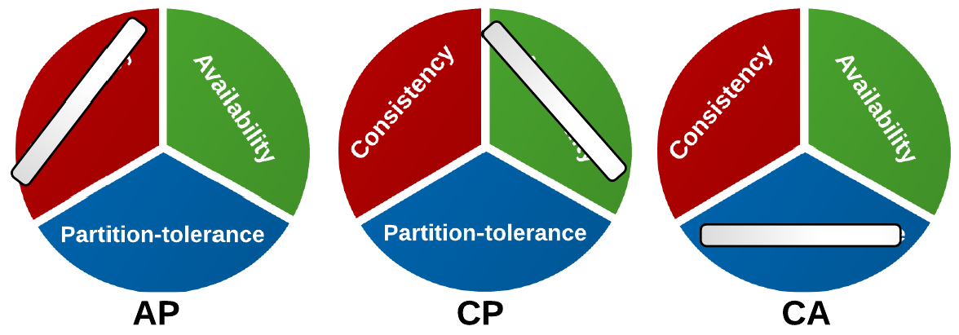
CAP Theorem
The CAP theorem states that a distributed computing system can only exhibit two of the three following characteristics:
Consistency: all nodes see the same data at the same time.
Availability: every request receives a response indicating success or failure.
Partition Tolerance: the system continues to operate even in the event of failure of part of the system or communication is lost
Notes:
The CAP Theorem states that you can have only two properties at once and there is a proof for it. If you do not really believe this theorem, you can try the intuitive explanations story, the plain English introduction to the CAP Theorem, which essentially plays in a scenario where two humans interact with each other providing a service and goes through all the steps and compensation strategies taken to achieve more than two, but it never works. So it is a very, very nice scenario-based story line that takes you into the CAP Theorem.

Slide 38

CAP Theorem
CAP started as a conjecture formulated by Eric Brewer in 2000 (thus also known as Brewer‘s Theorem). A formal proof was performed by Seth Gilbert and Nancy Lynch of MIT in 2002.
CAP Theorem
CAP proves that you can create a distributed database that is:
Consistent
Available
Partition-tolerant
Writes are atomic and all subsequent requests retrieve the new value.
Database will always return a value as long as a single server is running.
System will still function even if server communication is temporarily lost—for example, a network partition.
!
However, you can have only two properties at once.
For an intuitive explanation/story, check the Plain English Introduction: http://ksat.me/a-plain-english-introduction-to-cap-theorem/
Notes:
Narration
This topic relates to scalability, latency and consistency, which we have talked about earlier in the course.
The CAP Theorem started as a conjecture formulated by Eric Brewer in 2000, which is why it is also known as Brewer’s Theorem, but Seth Gilbert and Nancy Lynch of the MIT did the formal proof in 2002.
You can create a distributed system or distributed database that is consistent, meaning that writes are atomic and all subsequent requests retrieve a new value. This is nice because if a programmer sets a value and issues a get-write afterwards, the programmer typically expects to get the new value and not the old one back. That expectation is known as consistency.
You can also have the available property. The database will always return a value as long as a single server is running. That is a pretty nice property because you want the system to answer.
A system can be partition-tolerant which means the system will still function even if server communications are temporarily lost, like with a network partition.
The CAP Theorem states that you can have only two properties at once and there is a proof for it. If you do not really believe this theorem, you can try the intuitive explanations story, the plain English introduction to the CAP Theorem, which essentially plays in a scenario where two humans interact with each other providing a service and goes through all the steps and compensation strategies taken to achieve more than two, but it never works. So it is a very, very nice scenario-based story line that takes you into the CAP Theorem.

Slide 39
CAP Theorem: Effect in the Wild
The CAP Theorem can be displayed as a triangle with three different core combinations.
C
CA
RDBMS
A
CP
Banking
AP
DNS
P
Notes:
Narration
Visually, the CAP Theorem can be displayed as a triangle with three different core combinations. Typical RDBMS fall into the consistent property because we know RDBMS are based on ACID. Also, with RDBMS, you get availability. RDBMS is not really built for a partition tolerance because it was never designed for a distributed system. Typically, if you have a second server, it will never be fully in sync and will always lag behind, so you would lose consistency. RDBMS is purely in the CA area of the triangle.
With the AP extreme, you have availability and partition tolerance. An example would be a Domain Name System (DNS), which is essentially responsible for making an IP address out of Accenture.com or Amazon.com. DNS is like a dictionary. So you go in with a domain name and you get back an IP address. There are a lot of service providers that deal with DNS information. It is fully decentralized and there is a hierarchy in it where one set of service is responsible for dot coms. This service tells you where Amazon.com or Accenture.com or Microsoft.com is in the form of an IP address. Then, there are servers at Microsoft.com, Amazon.com and Accenture.com that give you information about the sub domain. For example, within Accenture.com, you have sub domains like myScheduling and myPerformance.
Now, all this information is cached globally. Whenever you look up a domain name somewhere in the world, you go to your DNS server that stores that information. That also means it is never fully consistent. For example, if you register a new domain name on an online service, the fine print always says it will take about 24 to 48 hours until this information perpetuates globally and your site is online. So that means it is never consistent, but it is always available and it is highly partition-tolerant. If one DNS server fails because an undersea cable is cut, for example, the DNS system just keeps on working.
Lastly, we have the CP extreme found in banking. When you use the ATM machine, the machine will always want to have a connection to the server. And, if it does not have a connection to the server, it will just tell you it is it not available. ATM's try to be consistent and partition-tolerant, but it can also switch its mode. It can say, well, I am offline, but I am switching into a special offline mode and can still give you cash, but only to a limit that is stored on your card. This is the ATM's offline mode.

Slide 40


CAP Theorem: Making the Right Choice
CAP should not be taken religiously, but its consequences are important. Understanding the consequences will help you make the right choice for your application. For a fully distributed system, P is a must.
C
CA
RDBMS
A
CP
Banking
AP
DNS
P
Typically, consistency is traded for a higher level of availability known as BASE: Basically Available, Soft state, Eventually consistent.
Notes:
Narration
Interestingly, the CAP Theorem should not be taken to these extremes so that you either choose CA or CP or AP. It is really about choosing the wisest point in the middle between the two extremes. Here, you have some questions to ask yourself about your system. Is it really necessary that the system stays fully available even if only one machine is left? Not necessarily. Out of a group of 10 machines, you might say if three die, you will still be running. If nine die, well, you might not be so sure. It is about making smart decisions and especially making smart decisions about consistency. Understanding the consequences of the CAP Theorem will help you make the right choice.
For a fully distributed system, partition tolerance is a must. You cannot really sacrifice the P because the P always happens. Data packages get lost, cables go away, network cards fail; in a distributed system, you really have to deal with the P. You can choose between how much availability to trade for consistency, but you can never have all three in the CAP Theorem.
This leads us to another acronym coined by Werner Vogels, the CTO of Amazon. Vogels wants a system that is BASE, which stands for Basically Available, Soft state and Eventually consistent. What Amazon does, and they employed it a lot, is to have some statistical evaluation to pretest. After a certain time with a certain probability, the system will be consistent or the state will be there. This is the approach they take.
Let us now move to our final foundational theory called Amazon's Dynamo.

Slide 41
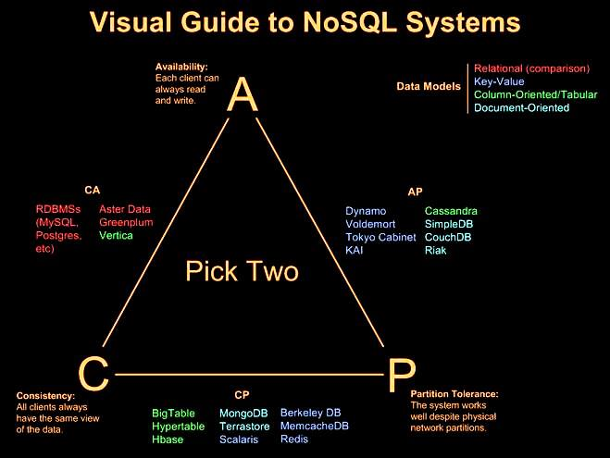
Big Data/NoSQL Vendors and the CAP Theorum

Slide 42
Scaling Out: Data Distribution Principles

Slide 43
Overview
NoSQL systems allow for data to be distributed over large clusters
Aggregate is a natural unit to use for data distribution.
Data can be distributed in to a single server or most commonly across multiples servers
There are two styles of distributing data:
Sharding
Replication

Slide 44
Data Sharding
Splitting different data across several nodes
Many NoSQL databases offer auto-sharding the database takes on the responsibility of sharding
dividing a data set across several servers provides horizontal scalability
Data accessed together on the same node ̶aggregate unit!
Main rules of sharding:
Place the data close to where it’s accessed  Orders for Boston: data in your eastern US data center
Try to keep the load even
All nodes should get equal amounts of the load
Put together aggregates that may be read in sequence
Same order, same node 
Notes:
As the data volume grows, scaling vertically is not the solution anymore. The solution is to scale horizontally, by adding servers instead of concentrating more capacity in a single server.
Sharding can also be achieved with SQL databases but is accomplished by very complex arrangements through SANs. SQL DBs do not provide this natively, the logic for the same has to be embedded in your application i.e. distribute the data, distributed queries, aggregate the results etc. Additional code is required to provide features such as failovers, data rebalancing, replication etc
NoSQL databases, on the other hand, usually support auto-sharding, i.e. without the application being aware of any such thing, they automatically distribute data across a number of servers. Data and query load are automatically balanced across servers, and when a server goes down, it can be quickly and transparently replaced with no application disruption.
Such kind of feature is most ably supported by Cloud Computing where you can add servers on demand to fulfil the needs

Slide 45
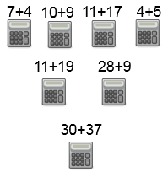

Why use Sharding?
Pros
Pros: it can improve both reads and writes
Speed up your application
No need to switch to storages which doesn't support SQL
Cons
Clusters use less reliable machine, which makes resilience decrease
If quantity of data increases, resharding might have to be performed. Resharding is error prone operation which usually cannot be performed on fly.
In practice, usually more difficult to maintain then alternative databases for huge data or with native support for parallelism.
7+4+10+9+11+17+4+5+6+7+12+8+9
versus

Slide 46
Replication
Data replication is important in keeping the database up and serving queries. Replication allows for copies (typically 3, but this number can be changed) of each piece of data in the database on different nodes. This is to allow a database to run continuously without human intervention, even if certain nodes fail.
Most NoSQL databases support automatic replication- allowing for high availability and disaster recovery.
Replication comes in two forms:
Master-slave replication makes one node the authoritative copy that handles writes while slaves synchronize with the master and may handle reads.
Peer-to-peer replication allows writes to any node; the nodes coordinate to synchronize their copies of the data.
Notes:
Master-slave replication reduces the chance of update conflicts but peerto-peer replication avoids loading all writes onto a single point of failure.
Data replication is the concept of having data, within a system, be geo-distributed; preferably through a non-interactive, reliable process. In traditional RDBMS databases, implementing any sort of replication is a struggle because these systems were not developed with horizontal scaling in mind. Instead, these systems can be backed up via a semi-manual process where live recovery wouldn’t be much of an issue. Even with live recovery not being much of an issue, it downplays the complexity of this setup. When dealing with today’s globally distributed data, the former colocated replication concepts will not suffice when implemented at geographic scale.
Today’s infrastructure requires systems that natively support active and real-time replication, achieved through transparent and simple configurations. The ability to dictate where and how your data is replicated via easily tunable settings, along with providing users with easily understood concepts is what modern day NoSQL databases strive to offer.

Slide 47
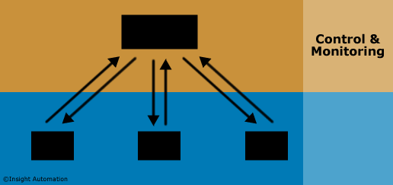
Master/Slave Replication
In a Master/Slave configuration (sometimes referred to as Primary/Secondary), one centralized "master" device handles all the logic, and controls all of the "slave" devices.
Each slave devise communicates back to the master device
Notes:
In a Master/Slave configuration (sometimes referred to as Primary/Secondary), one centralized "master" device handles all the logic, and controls all of the "slave" devices.
Each slave device typically requires a dedicated communications conduit back to the master device. In practice, this means a generous amount of wiring must be done to set up the average Master/Slave configuration. This tangle of wiring can be greatly alleviated, however, by placing all of the devices on a single network. Slave devices still must receive control from the master device, but communication can effectively be daisy-chained via the network.
Because all control processing happens in the master device, Master/Slave configurations sometimes suffer from bandwidth bottlenecking, as well as from the creation of a single point of failure. If the master device malfunctions, the entire system comes to a halt. Fortunately, because all the "smarts" in the system are centrally located in the master device, finding the physical location of the problem is relatively easy.

Slide 48
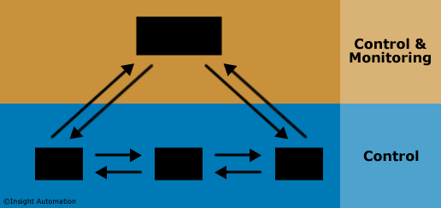
Peer-to-Peer Replication
In a Peer-to-Peer configuration, control and communication is distributed among devices in the field. Each device communicates directly with the devices around it, without having to go through a master device.
Notes:
In a Peer-to-Peer configuration, control and communication is distributed among devices in the field. Each device communicates directly with the devices around it, without having to go through a master device. A master may be present for the purpose of monitoring the system and injecting commands, but its presence is not necessary for the peer devices to function.
Because each peer device is effectively both "master" and "slave," the potential for bandwidth bottlenecks is eliminated. Moreover, wiring is drastically simplified because peer devices can be daisy-chained, rather than tethered directly to a master device.
In a peer-to-peer configuration, if one device goes down, the other devices can continue to function normally. Each device knows what it is supposed to do, independent of the other devices. In practice, this can be both beneficial and frustrating. If you did not have a monitoring device in the system, you would have to check each peer device individually to find the point of failure.

Slide 49
Introductory Lecture Wrap-Up

Slide 50
Course Conclusion
Please keep in mind the following points:
The amount of data available today is complex and growing exponentially
Relational database management systems (RDBMS) have a property called ACID (atomicity, consistency, isolation and durability). However, those properties are challenging in today’s world of big data because there is limited scalability, and it is very hard to deal with latency.
In addition to the scalability and latency issues, there is also the challenge of data changing in nature.
NoSQL can be used as a tool to process and analyze unstructured datasets
The main advantages of NoSQL include high scalability, dynamic schema, low latency and high performance
Notes:
Narration
These points are important and key concepts to remember.

Slide 51
Course Conclusion
Please keep in mind the following points:
Since NoSQL is still a new technology, there is not much expertise available which can pose some challenges depending on the business needs
Data distribution principles for scaling out include Sharding and Replication
In a distributed system, managing consistency(C), availability(A) and partition toleration(P) is important, Eric Brewer put forth the CAP theorem which states that in any distributed system we can choose only two of consistency, availability or partition tolerance.
In order to access the cluster servers, Linux is utilized as a platform and the user communicated with the cloud through Linux communicated with UNIX command
Notes:
Narration
These points are important and key concepts to remember.
Since NoSQL is still a new technology, there is not much expertise available which can pose some challenges depending on the business needs
Data distribution principles for scaling out include Sharding and Replication
In a distributed system, managing consistency(C), availability(A) and partition toleration(P) is important, Eric Brewer put forth the CAP theorem which states that in any distributed system we can choose only two of consistency, availability or partition tolerance.
In order to access the cluster servers, Linux is utilized as a platform and the user communicated with the cloud through Linux communicated with UNIX command

Slide 52
Lab Week 1

Slide 53
Lab 1a: Setup of environment

Slide 54
Lab Exercise – General structure
For the labs in this training we will use one common use case, based on a couple of thousands of blog posts, comments and responses, downloaded from www.stackexchange.com.
All labs use the same model:
A simple web app is running in node.js (javascript on the server)
You can view this web app in your browser on http://localhost:3000/
Node.js runs a database driver that connects to the database, that runs locally on your workstation
All components are installed locally in your Windows 7 environment
browser
node.js
database
Web application
node.js
db driver

Slide 55
Lab Exercise – node.js = javascript on the server
The applications for the labs run in node.js
Node.js is an execution platform for javascript code
Based on Google’s javascript engine inside Chrome, ‘V8’
This V8 has been taken out of the browser context, and a new server context has been wrapped around it, resulting in node.js
Node.js drivers are available for all the databases covered in this course

Slide 56
Lab Exercise – use of javascript
Students are expected to have a basic background in programming
If you don’t know javascript, give it a try, it’s a fairly easy language to grasp
For each lab, study the code of the application
The main concepts used in javascript in these labs are:
Express, a simple http server for node.js
JSON, javascript object notation. See http://www.json.org for specs
Callbacks and the event loop.
If you are not comfortable on these topics, take time to study them, there are plenty of good videos available on YouTube.

Slide 57



Lab Exercise – lab 1a: Environment setup
For lab 1a instructions are provided to install
Node.js
Microsoft Visual Studio Code as editor for the javascript code of the application
Git Bash for a command line interface that you might find easier to use compared to Windows’ own CMD.exe
Some simple hello world assignments test if installation was successful.
Installers for the databases will be provided in next labs

Slide 58
Lab Documents
Are in your course folder as a separate Word Document

Slide 59
Lab 1b: A simple node.js application

Slide 60
Lab Exercise – Lab 1b: a simple node.js application
Lab 1b explores a very simple Express application that uses a simulated database
All following labs will use an application, the application for this week is the simplest one.
Real databases will be introduced in the next labs
The app shows the general structure and the use of JSON
The application is built based on a demo that is available on YouTube. This 40 min. video is recommended material
The lab instructions will sometimes ask to make screenshots or provide other proof of your work.
Be sure to upload this material via the desire2learn training portal, otherwise you won’t get credit for the course

Slide 61
Lab Documents
Are in your course folder as a separate Word Document

Slide 62
A Little Housekeeping…

Slide 63
Course Feedback
All Users: After completion of the course, you will receive a survey. Please complete this in a timely manner.
Notes:
Narration
Please read these important notes about getting completion credit for this course. This concludes the noSQL Essentials course.

Slide 64
Plan for Remaining Weeks
Week 2 : Key-Value Databases
Redis
Riak
Week 3 : Document Storage Databases
MongoDB
CouchDB
Week 4 : Column Oriented Storage Databases
Cassandra
HBase
Week 5 : Graph Databases
Neo4j
Beyond Neo4j
Notes:
Narrative:

